Slide 1




FLIGHT BOOKING
SYSTEM
SOLID PRINCIPLES

Slide 2
Group#1 Members
Muhammad Zohaib
Kashif
Areeba
Aneela
Code + documentation
Code + research
Code + research
Code + research

Slide 3

Salient Features:
01
Searching the flight
02
Calculating the pricing
04
03
Allocating Seats
Handling the passenger profile
Payment Gateway
processing
05
06
Creating & managing Bookings
07
08
Storing data in Repositories
Sending Notifications

Slide 4
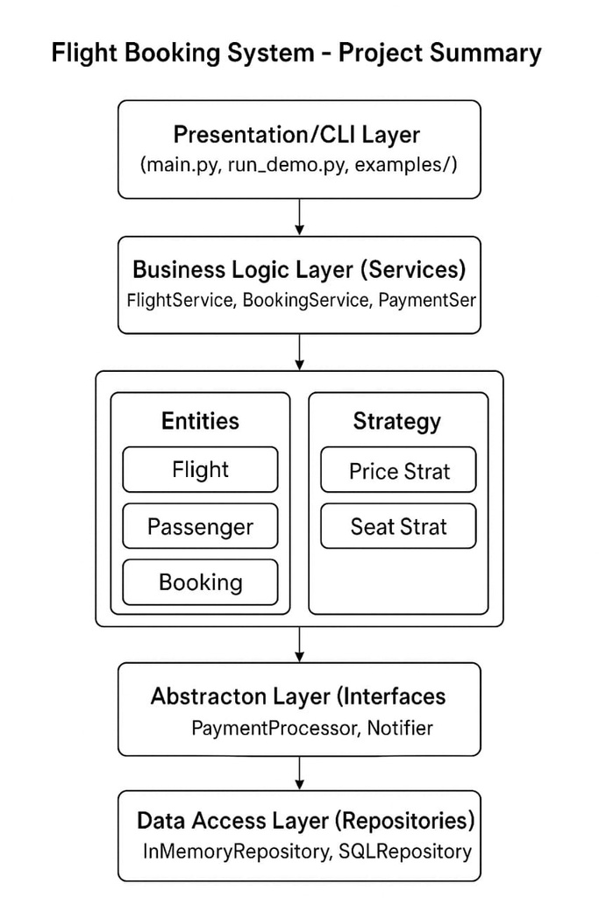
Directory structure:

Slide 5
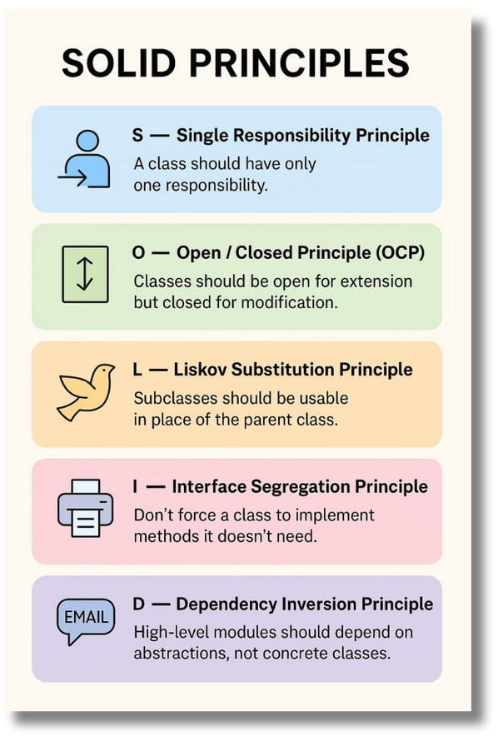
SOLID PRINCIPLES:
01
Single responsibility - SRP
03
Open Close principle - OCP
1 class == 1 work
Open for addition
but close for changes.
02
Liskov substitution - LSP
04
Interface segregation - ISP
Substitute classes can use same methods.
Separate interface for separate work.
05
Dependency inversion - DIP
High level classes depend on abstraction.

Slide 6
Pricing & Seating strategies
Pricing strategies
Seating strategies
Sequential
Family
window
priority
Dynamic
Standard
Seasonal
Loyalty

Slide 7
Interfacez
(abstractions)
Def:
A solid map or blueprint to use real process
Passanger op: select,book the flight etc
Admin op: Add,cancel or go the flight etc
Notifier: notify passenger by sms,email
Payment: Paypal, Stripe, Easypaisa etc

Slide 8
Run the project
STEP1: Open the terminal.
STEP2: Select PowerShell with gitbash.
STEP3: Type "Python main.py" & enter.

Slide 9
Conclusion
A project made in Python based on
backend functionalities to provide convenience
of Db of Flight system much impactful.

